Slide 1

Comparison of Bidirectional LSTM and Attention Models for Natural Language Processing Tasks
By Daniel Ferguson and Karthik reddy mettu

Slide 2
Emotion Analysis: Why?
Human communication is inherently emotional.
Tailoring of NLP product responses to user input.
Market research and customer feedback analysis.
Mental health assessment.

Slide 3
Emotion Analysis: Challenges
Emotions are inherently subjective and context dependent!
Textual expressions of emotion are often ambiguous…
Many different emotions, many of which overlap.
Lack of high-quality training data.

Slide 4
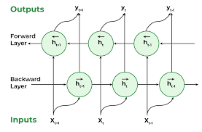
Bidirectional RNN Architecture
RNNs process data a sequence of vectors rather than a fixed length vector as in feed forward networks.
Each vector in the sequence is processed depending on the hidden state from the previous phase.
A Bidirectional RNN layers two RNNs together, one updating the hidden state based on the current input and prior hidden state (forward) and the other updating its hidden state based on the current input and the next hidden state (backward). The hidden states of both RNNs are used in calculating the final output.
BRNNs preserve the context of previous and future elements in the sequence.

Slide 5
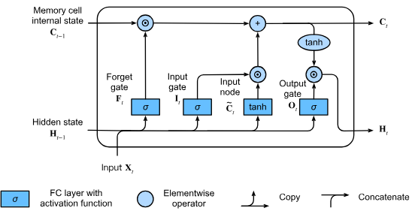
LSTM Architecture
BRNNs run into the issue of vanishing gradients when processing long sequences.
LSTMs solve this problem by introducing a memory cell with four components.
An input gate which determines how much new data we consider.
A forget gate which determines how much of the old hidden state we retain.
An input node is used to create new information to be inserted into memory.
An output gate which determines if the internal state of a given neuron should impact the cell’s output at the current time step.
The LSTM receives three vectors as input
The cell state which acts as long-term memory
The hidden state which acts as short-term memory
The input vector which acts as new information

Slide 6

Emotion Analysis: The Data

Slide 7
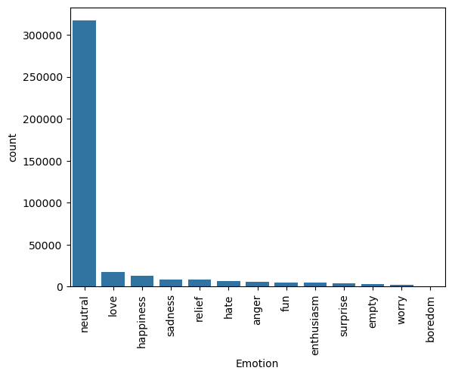
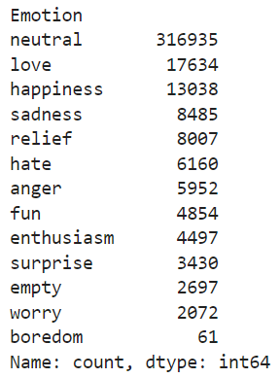
Distribution of Emotions

Slide 8

Happiness

Slide 9

Boredom

Slide 10

Empty

Slide 11
Tokenization
We need to convert our data into a form our model can recognize: numbers.
Using a tokenizer we can create a dictionary which maps each unique word to an integer.
We then convert each tweet into a sequence of tokens.
“i seriously hate one subject to death but now i feel reluctant to drop it”
[2,3,14,59,9,2,88,355,79,4,355,50,182,22,32,172,10,1294,105,226]

Slide 12
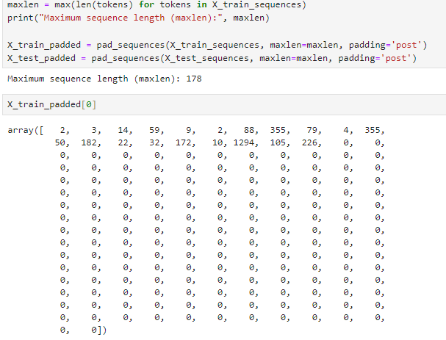
Padding
Our models expects our inputs to be of uniform length.
To achieve this, we ‘pad’ each of our tokenized sequences with 0’s.

Slide 13
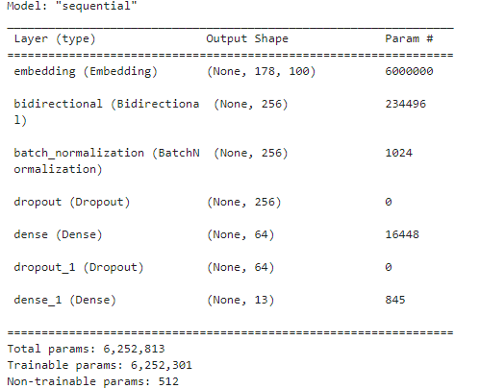
LSTM Model

Slide 14
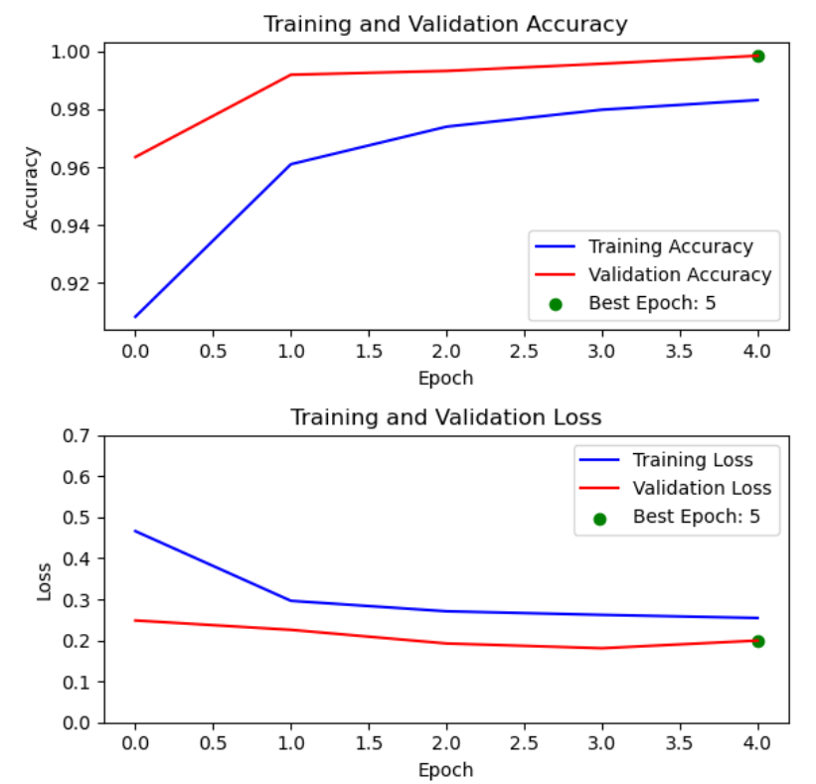
LSTM Model Performance
Our model was trained over 5 epochs.
Each epoch lasted approximately 12 minutes for a total training time of 60 minutes on an RTX 4060 GPU.
Our model achieved a maximum validation accuracy of 99.2%

Slide 15
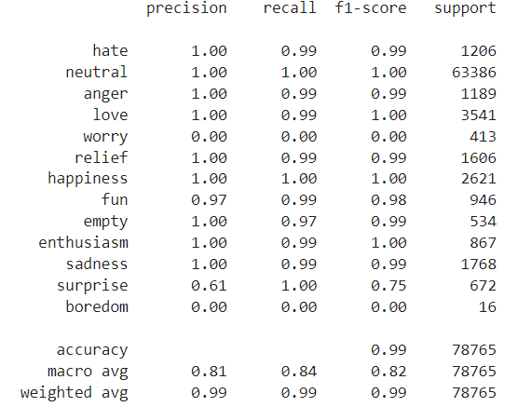
LSTM Model Performance Metrics
Precision: The ability of a classifier to avoid false positives: (TP/(TP+FP))
Recall: The ability of a classifier to find all positive samples: (TP/(TP+FN))
F1-Score: A measure of predictive performance: (TP/(TP + .5(TP + FN))
Support: The number of occurrences of each class in the test dataset.

Slide 16
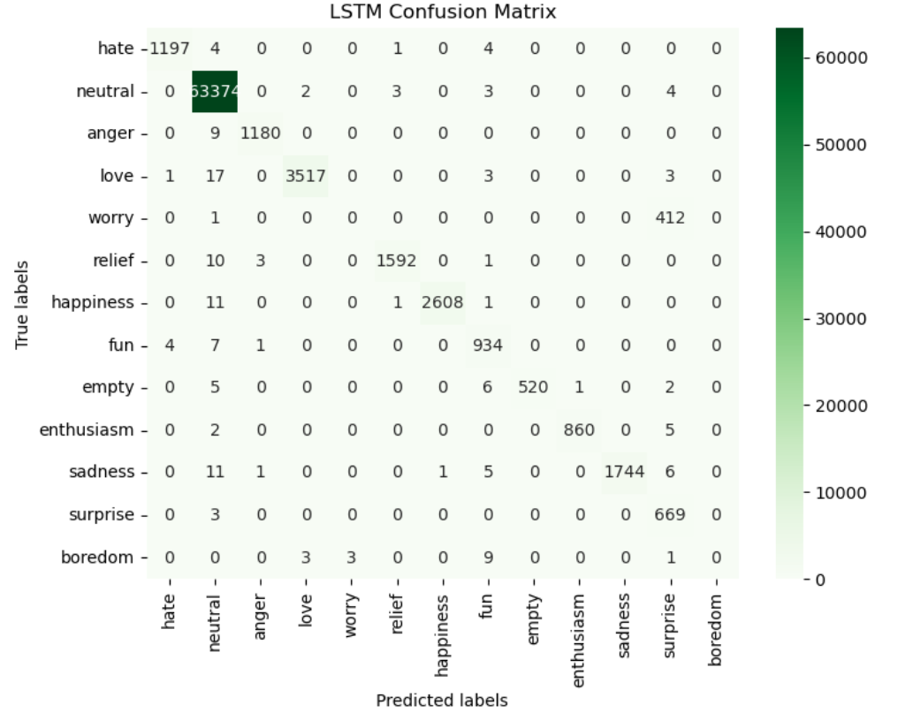

Slide 17
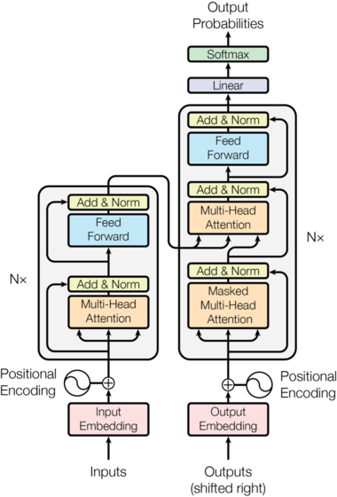
Transformer Architecture
Transformers follow encoder-decoder models using stacked self attention and fully connected layers for both the encoder and decoder.
The encoder converts a vector of words into an embedding with positional context. This embedding is passed through a multi-headed attention layer and a fully connected layer to create a representation of the learned information from the sequence.
The decoder passes the target sequence through a multi-headed attention layer and the encoded representation through a masked-multi-headed attention layer to generate a text sequence.
Figure 3: Transformer Architecture. Credit: https://nlp.seas.harvard.edu/images/the-annotated-transformer_14_0.png

Slide 18
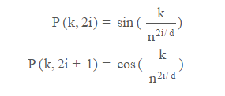
Transformer: Positional Encoding
Transformers handle each token in the embedding sequence independently of all others.
They lack a recurrence mechanism to retain information about a token’s position.
Instead, transformers create a positional encoding matrix made up of sinusoids generated from the positions of tokens in the input sequence.
The sinusoids for each position is different, and the similarity between sinusoids can be measured to calculate the relative position of words.
k = Position of toke in input sequence
d = Dimension of output embedding space
P(k,j) = Function which maps k in input sequence to (k,j) in positional encoding matrix
n = user defined scalar
i = column index for encoding matrix

Slide 19
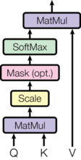
Transformers: Attention Mechanism
Transformers rely on the attention mechanism to determine the relative importance of inputs.
An attention function maps a query and set of key-value pairs to an output, producing an attention score for each word.
Multi-headed attention splits the query, key, and value parameters among several attention heads and later combines the calculations into a final attention score. This allows the transformer to encode multiple relationships.

Slide 20
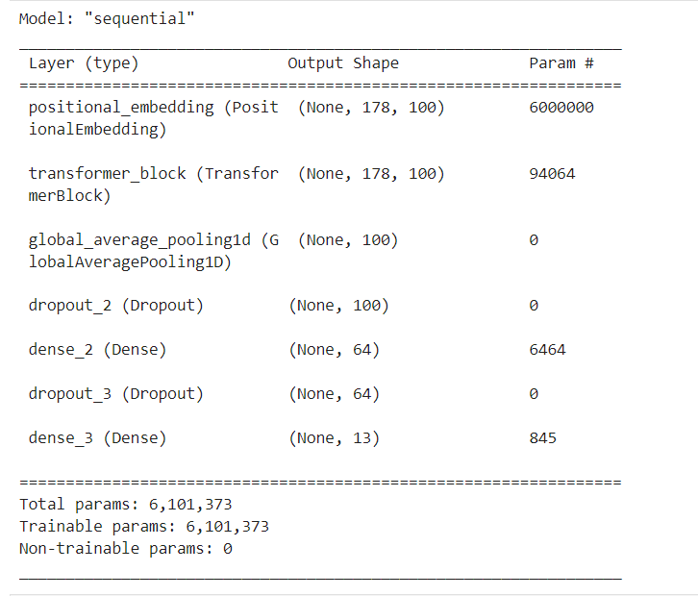
Transformer Model

Slide 21
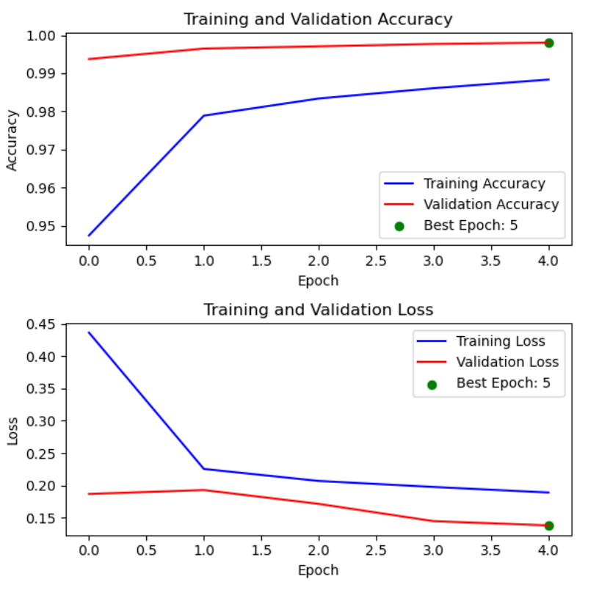
Transformer Model Performance
Our transformer model achieved peak validation accuracy of 99.80%
Total training time on an RTX 4060 was 14 minutes.

Slide 22
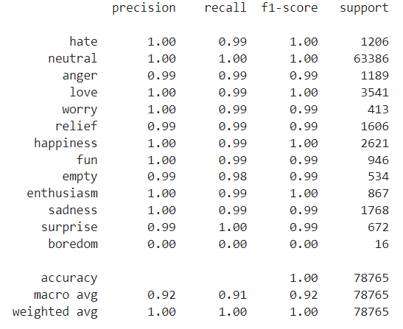
Transformer Performance Metrics
Precision: The ability of a classifier to avoid false positives: (TP/(TP+FP))
Recall: The ability of a classifier to find all positive samples: (TP/(TP+FN))
F1-Score: A measure of predictive performance: (TP/(TP + .5(TP + FN))
Support: The number of occurrences of each class in the test dataset.

Slide 23
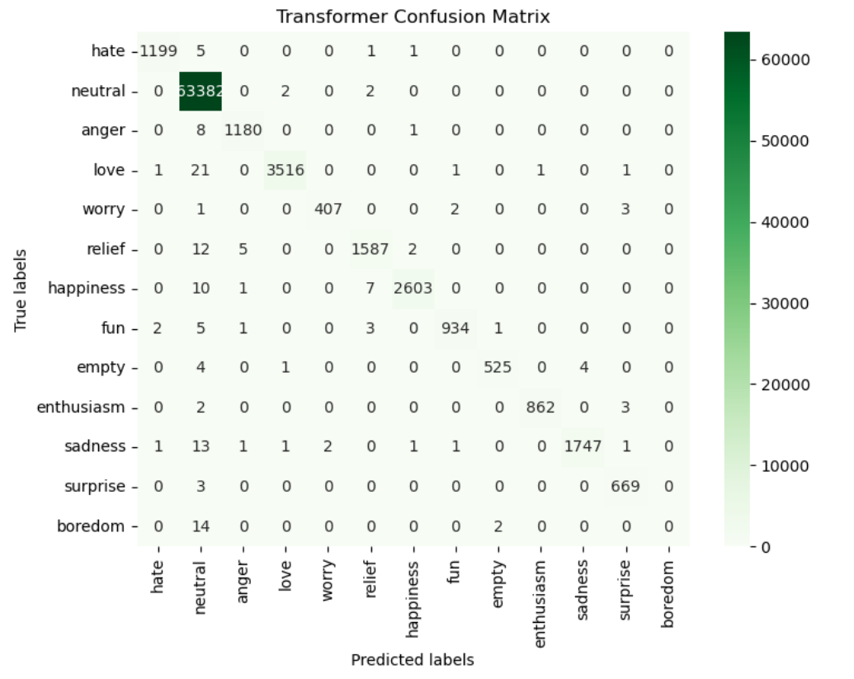

Slide 24
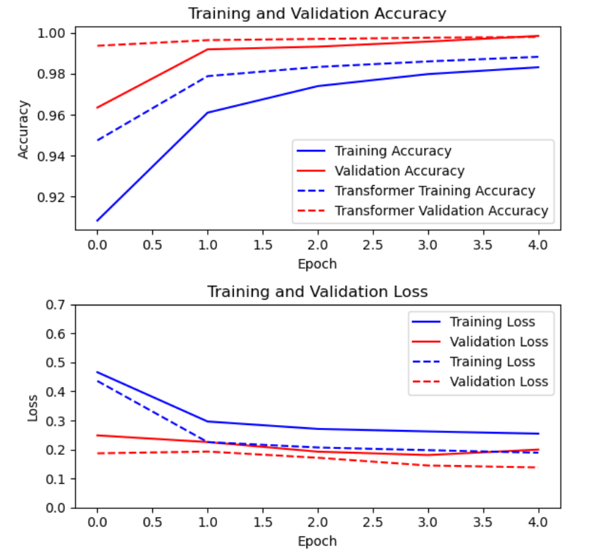
Model Comparison
Total training time:
LSTM = 60 Minutes
Transformer = 14 Minutes
Accuracy:
LSTM:
Epoch 1: 94.8%
Epoch 5: 99.2%
Transformer:
Epoch 1: 99.4%
Epoch 5: 99.8%

Slide 25

Where are the Models Making Mistakes?

Slide 26
Works Cited
Gers, Felix A., and E. Schmidhuber. "LSTM recurrent networks learn simple context-free and context- sensitive languages." IEEE transactions on neural networks 12.6 (2001): 1333-1340.
Vaswani, Ashish; Shazeer, Noam; Parmar, Niki; Uszkoreit, Jakob; Jones, Llion; Gomez, Aidan N; Kaiser, Łukasz; Polosukhin, Illia (2017). "Attention is All you Need" (PDF). Advances in Neural Information Processing Systems. 30. Curran Associates, Inc.

